Slide 1
Value Function Approximation

Slide 2
Outline
Recap on Q-Learning
Introduction

Slide 3
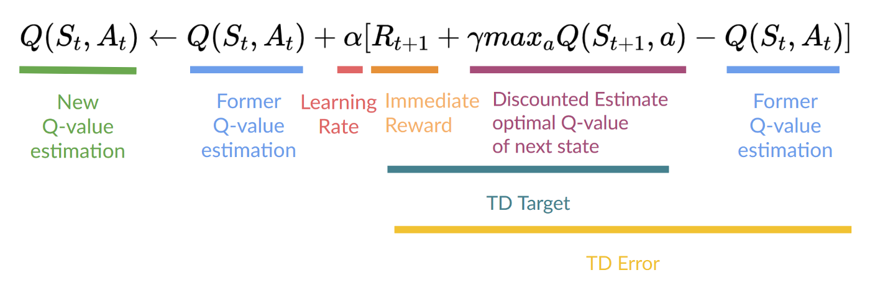




$$S_{t},A_{t}$$
$$R_{t+1}$$
$$S_{t+1}$$
$$a$$

Slide 4
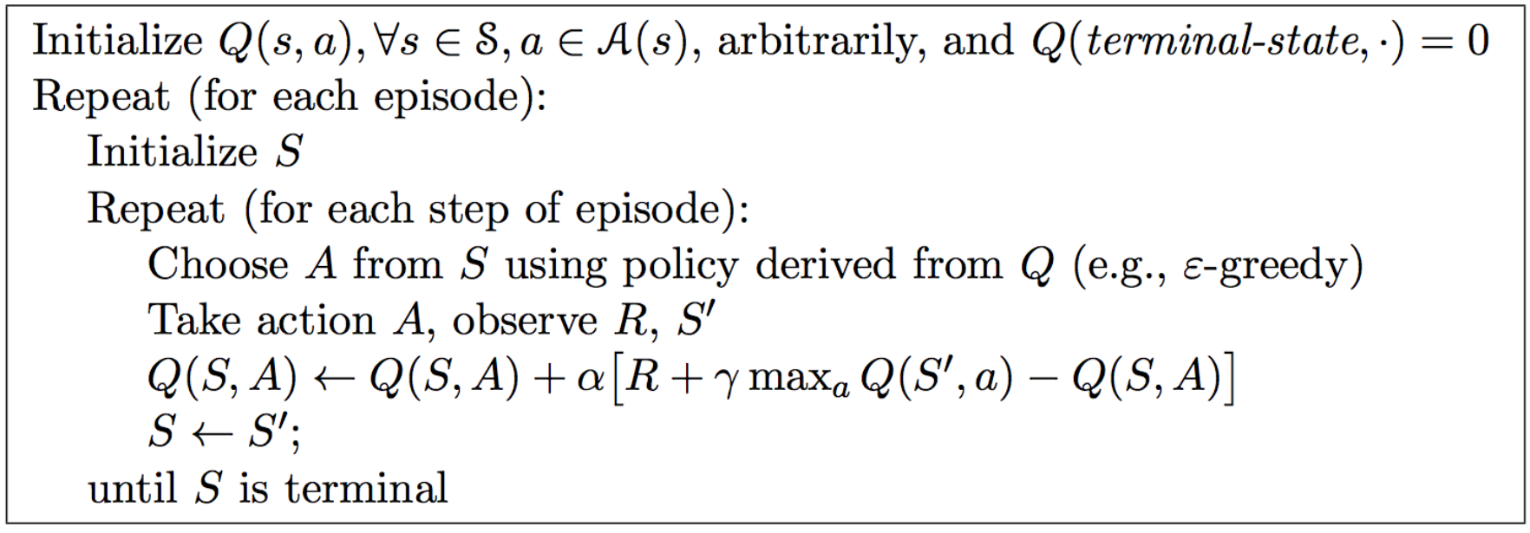
Q-learning algorithm for Off-Policy Control

Slide 5
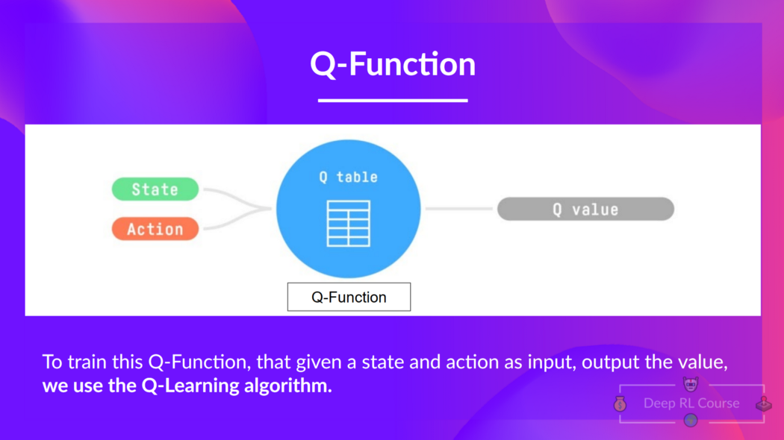
Q-Learning
INTRODUCTION TO COMPUTING
Course Code: CCINCOM/L
Joseph Marvin R. Imperial
REINFORCEMENT LEARNING
NU College of Computing and Information Technologies
Course Code: CCRNFLRL

Slide 6
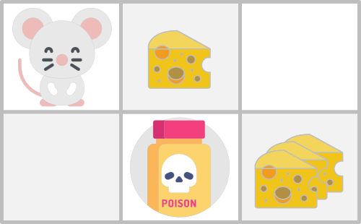
Course Code: CCINCOM/L
Joseph Marvin R. Imperial
REINFORCEMENT LEARNING
NU College of Computing and Information Technologies
Course Code: CCRNFLRL

Slide 7
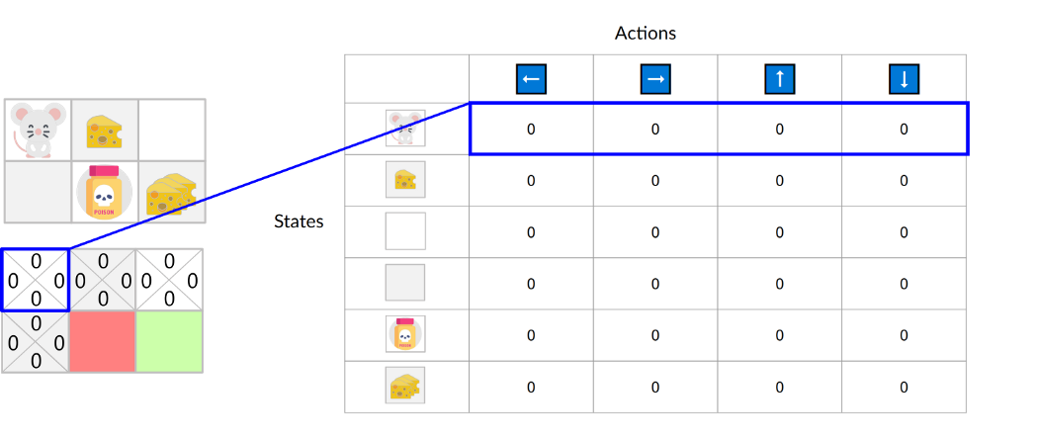
Course Code: CCINCOM/L
Q-Table is just a simple lookup table where we calculate the maximum expected future rewards for action at each state
This table will guide us to the best action at each state.
Joseph Marvin R. Imperial
REINFORCEMENT LEARNING
NU College of Computing and Information Technologies
Course Code: CCRNFLRL

Slide 8
Course Code: CCINCOM/L
The Q-table is initialized. That’s why all values are = 0. This table contains, for each state and action,
the corresponding state-action values.
Joseph Marvin R. Imperial
REINFORCEMENT LEARNING
NU College of Computing and Information Technologies
Course Code: CCRNFLRL

Slide 9
Course Code: CCINCOM/L
For this simple example, the state is only defined by the position of the mouse.
Joseph Marvin R. Imperial
REINFORCEMENT LEARNING
NU College of Computing and Information Technologies
Course Code: CCRNFLRL

Slide 10
Course Code: CCINCOM/L
Therefore, we have 2 x 3 rows in our Q-table, one row for each possible position of the mouse
Joseph Marvin R. Imperial
REINFORCEMENT LEARNING
NU College of Computing and Information Technologies
Course Code: CCRNFLRL

Slide 11
Course Code: CCINCOM/L
Here we see that the state-action value of the initial state and going up is 0:
Joseph Marvin R. Imperial
REINFORCEMENT LEARNING
NU College of Computing and Information Technologies
Course Code: CCRNFLRL

Slide 12
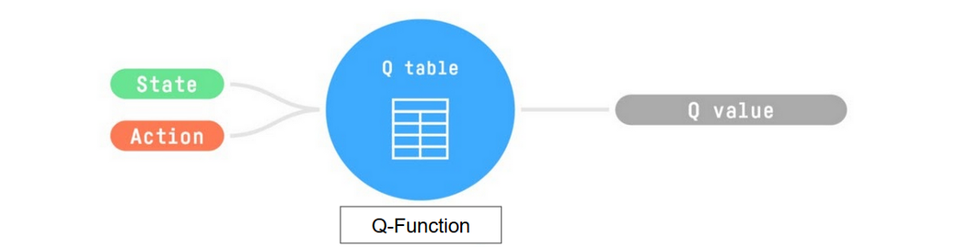
Course Code: CCINCOM/L
So, the Q-function uses a Q-table that has the value of each state-action pair.
Joseph Marvin R. Imperial
NU College of Computing and Information Technologies
Course Code: CCRNFLRL

Slide 13
Course Code: CCINCOM/L
Given a state and action, our Q-function will search inside its Q-table to output the value.
Joseph Marvin R. Imperial
REINFORCEMENT LEARNING
NU College of Computing and Information Technologies
Course Code: CCRNFLRL

Slide 14
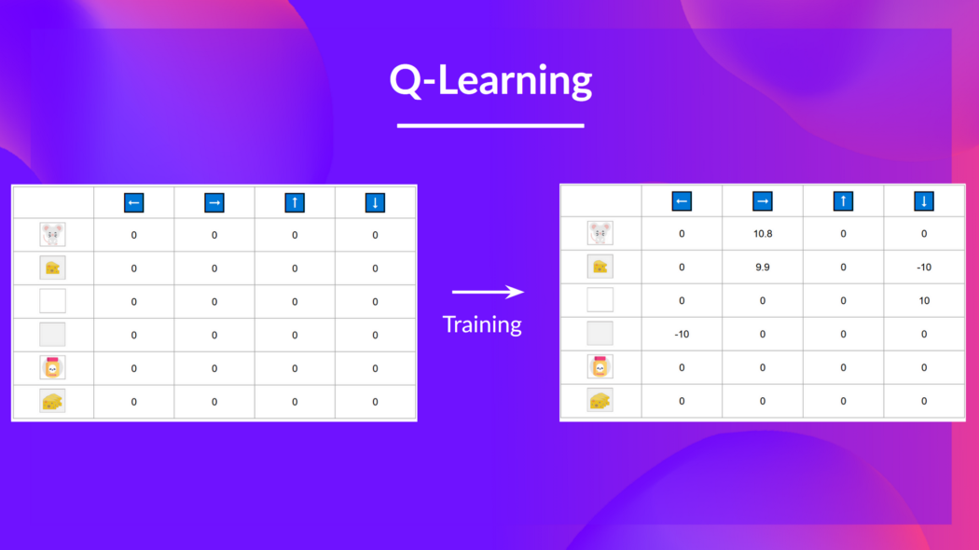
Q-Learning
INTRODUCTION TO COMPUTING
Course Code: CCINCOM/L
In the beginning, our Q-table is useless since it gives arbitrary values for each state-action pair (most of the time, we initialize the Q-table to 0).
Joseph Marvin R. Imperial
REINFORCEMENT LEARNING
NU College of Computing and Information Technologies
Course Code: CCRNFLRL

Slide 15
Q-Learning
INTRODUCTION TO COMPUTING
Course Code: CCINCOM/L
As the agent explores the environment and we update the Q-table, it will give us a better and better approximation to the optimal policy.
Joseph Marvin R. Imperial
REINFORCEMENT LEARNING
NU College of Computing and Information Technologies
Course Code: CCRNFLRL

Slide 16
Q-Learning
INTRODUCTION TO COMPUTING
Course Code: CCINCOM/L
We see here that with the training, our Q-table is better since, thanks to it, we can know the value of each state-action pair.
Joseph Marvin R. Imperial
REINFORCEMENT LEARNING
NU College of Computing and Information Technologies
Course Code: CCRNFLRL

Slide 17
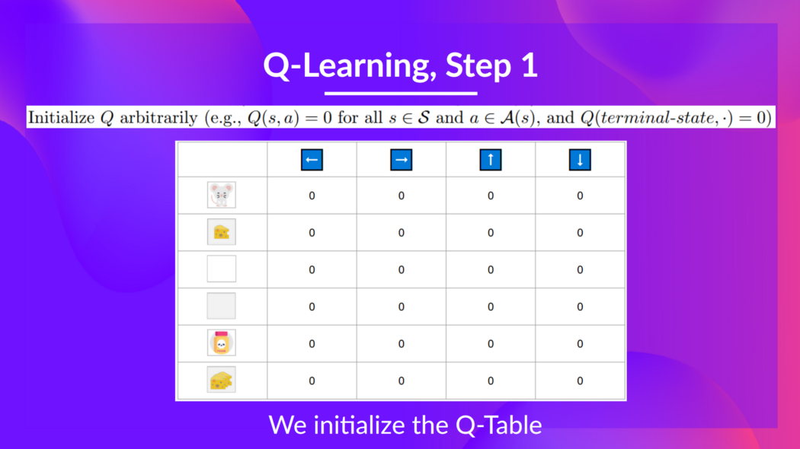
Q-Learning
INTRODUCTION TO COMPUTING
Course Code: CCINCOM/L
Joseph Marvin R. Imperial
REINFORCEMENT LEARNING
NU College of Computing and Information Technologies
Course Code: CCRNFLRL

Slide 18
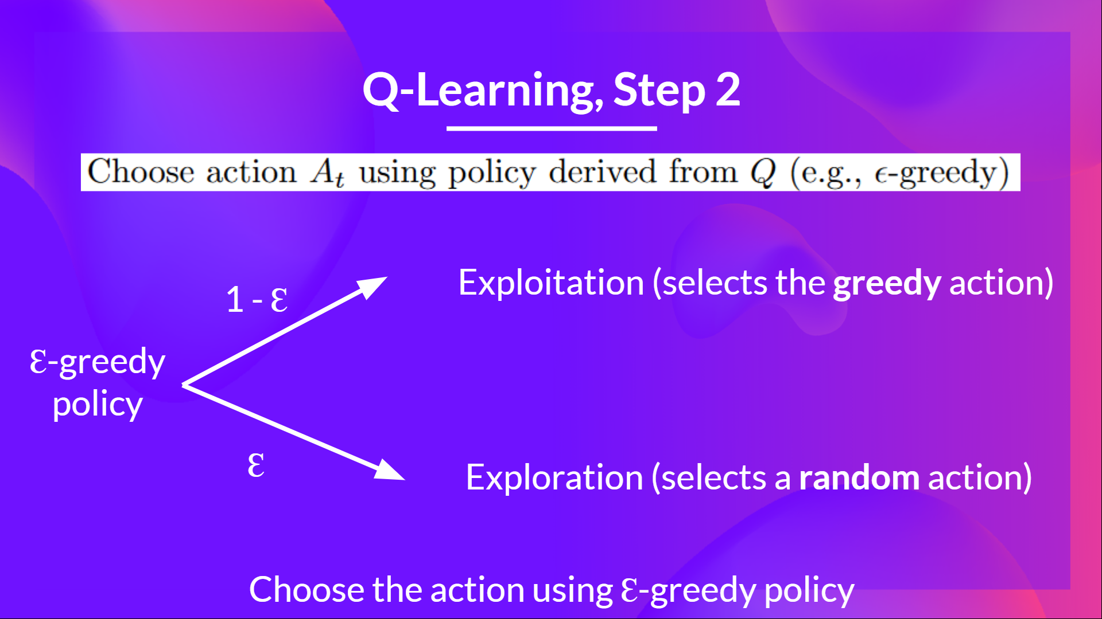
Q-Learning
INTRODUCTION TO COMPUTING
Course Code: CCINCOM/L
Joseph Marvin R. Imperial
REINFORCEMENT LEARNING
NU College of Computing and Information Technologies
Course Code: CCRNFLRL

Slide 19
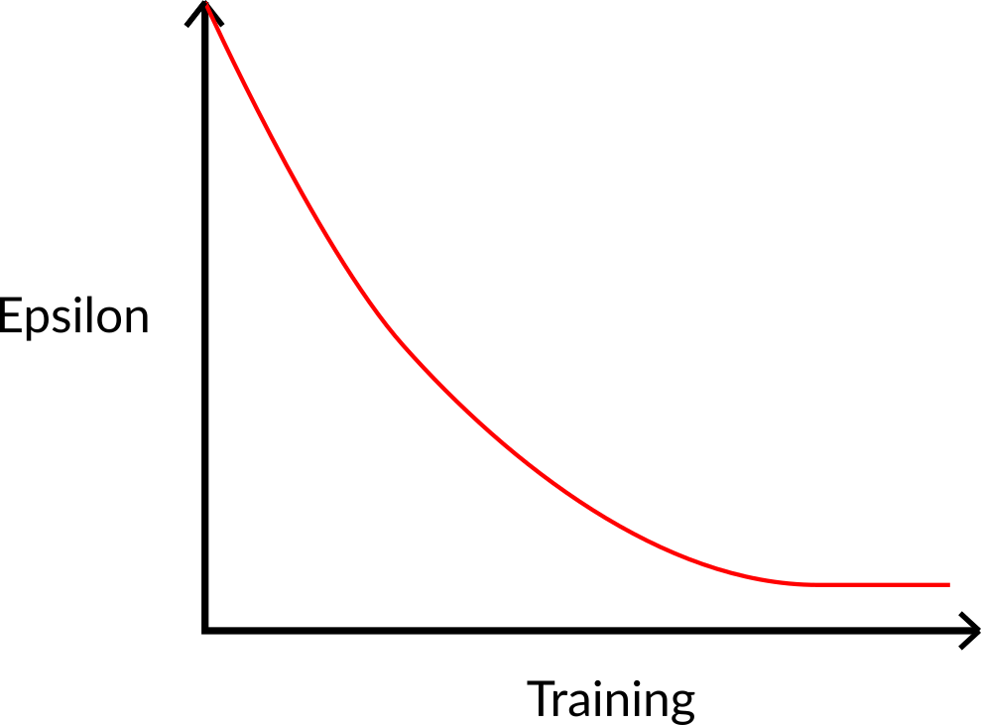
Step 2: Choose an Action using the epsilon-greedy strategy
INTRODUCTION TO COMPUTING
Course Code: CCINCOM/L
Joseph Marvin R. Imperial
REINFORCEMENT LEARNING
NU College of Computing and Information Technologies
Course Code: CCRNFLRL

Slide 20
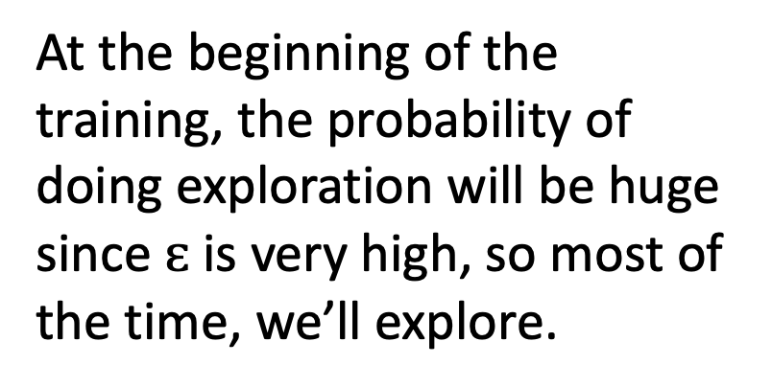
Step 2: Choose an Action using the epsilon-greedy strategy
INTRODUCTION TO COMPUTING
Course Code: CCINCOM/L
At the beginning of the training, the probability of doing exploration will be huge since $ɛ$ is very high, so most of the time, we’ll explore.
Joseph Marvin R. Imperial
REINFORCEMENT LEARNING
NU College of Computing and Information Technologies
Course Code: CCRNFLRL

Slide 21
Step 2: Choose an Action using the epsilon-greedy strategy
INTRODUCTION TO COMPUTING
Course Code: CCINCOM/L
But as the training goes on, and consequently our Q-table gets better and better in its estimations.
Joseph Marvin R. Imperial
REINFORCEMENT LEARNING
NU College of Computing and Information Technologies
Course Code: CCRNFLRL

Slide 22
Step 2: Choose an Action using the epsilon-greedy strategy
INTRODUCTION TO COMPUTING
Course Code: CCINCOM/L
We progressively reduce the epsilon value since we will need less and less exploration and more exploitation.
Joseph Marvin R. Imperial
REINFORCEMENT LEARNING
NU College of Computing and Information Technologies
Course Code: CCRNFLRL

Slide 23

Step 3: Perform Action, Get Reward and Next State
INTRODUCTION TO COMPUTING
Course Code: CCINCOM/L
Joseph Marvin R. Imperial
REINFORCEMENT LEARNING
NU College of Computing and Information Technologies
Course Code: CCRNFLRL

Slide 24
Step 4: Update Q-value
INTRODUCTION TO COMPUTING
Course Code: CCINCOM/L
Joseph Marvin R. Imperial
REINFORCEMENT LEARNING
NU College of Computing and Information Technologies
Course Code: CCRNFLRL

Slide 25
Outline
Recap on Q-Learning
Introduction

Slide 26
Limitations of Q-learning
Producing and updating a Q-table can become ineffective in large state space environments.
In our previous example, the environment was relatively simple because the state space was discrete and small ( 6 states )

Slide 27
Limitations of Q-learning
The problem is that Q-Learning is a tabular method. It is not scalable.
This becomes a problem if the states and actions spaces are not small enough to be represented efficiently by arrays and tables.
Q-Learning worked well with small state space environments like:
FrozenLake, we had 16 states.
Taxi-v3, we had 500 states.

Slide 28

Limitations of Q-learning
Other Atari environments like Space Invaders, have an observation space with a shape of (210, 160, 3)*, containing values ranging from 0 to 255 so that gives us ${256}^{210∗160∗3}$ = ${256}^{100800}$ possible observations (for comparison, we have approximately ${10}^{80}$ atoms in the observable universe).

Slide 29
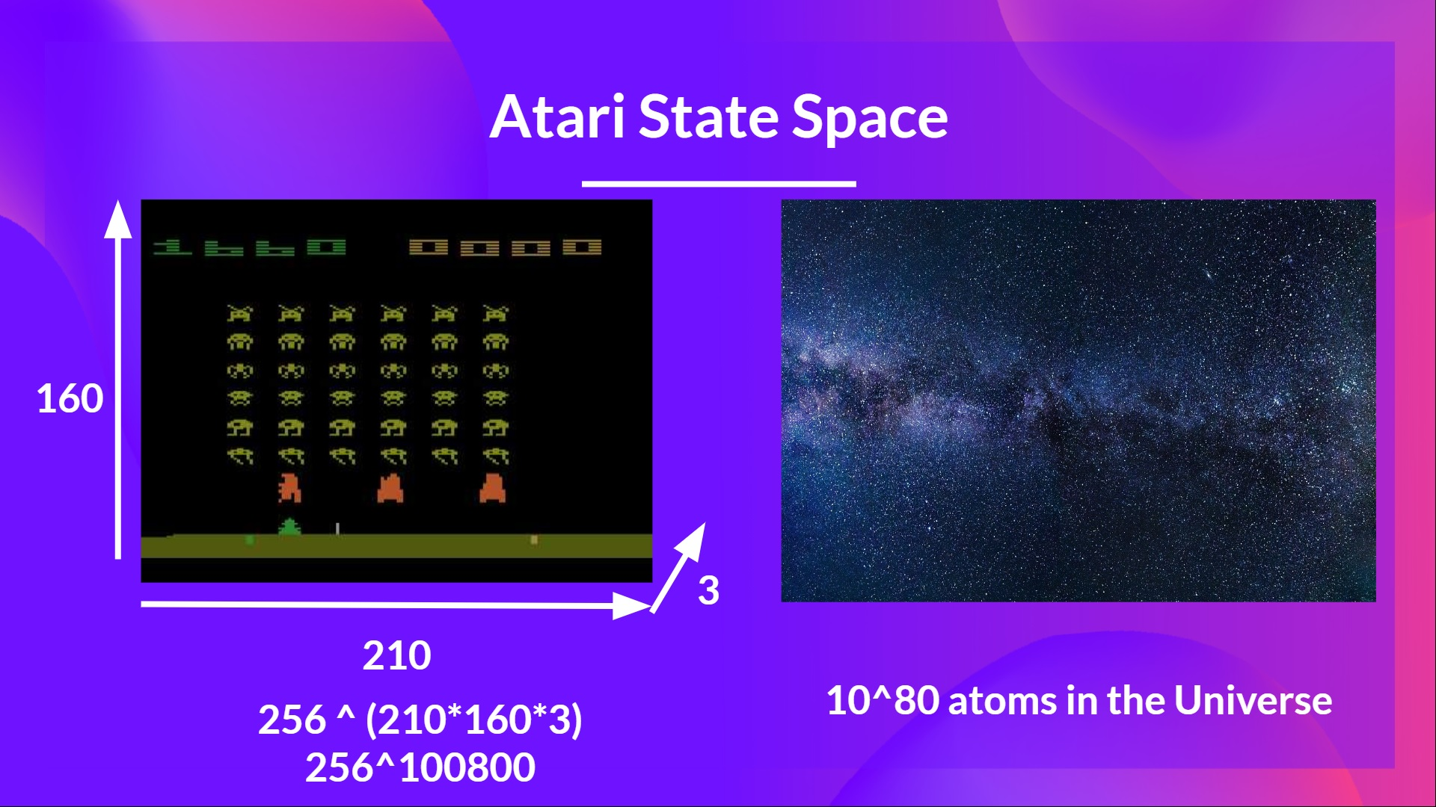

Slide 30
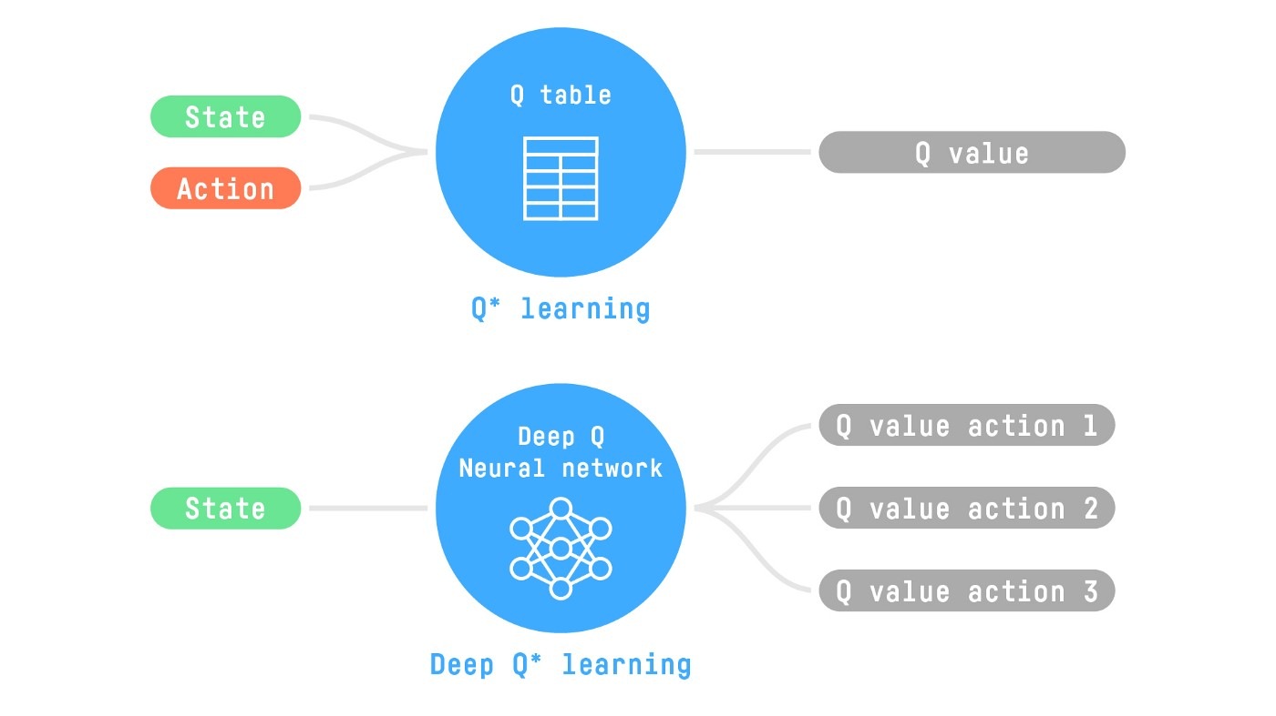
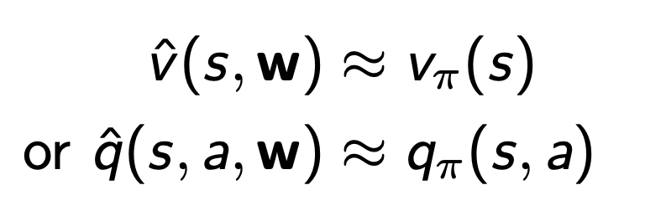
Value Function Approximation
In this case, the best idea is to approximate the value function using function approximation

Slide 31
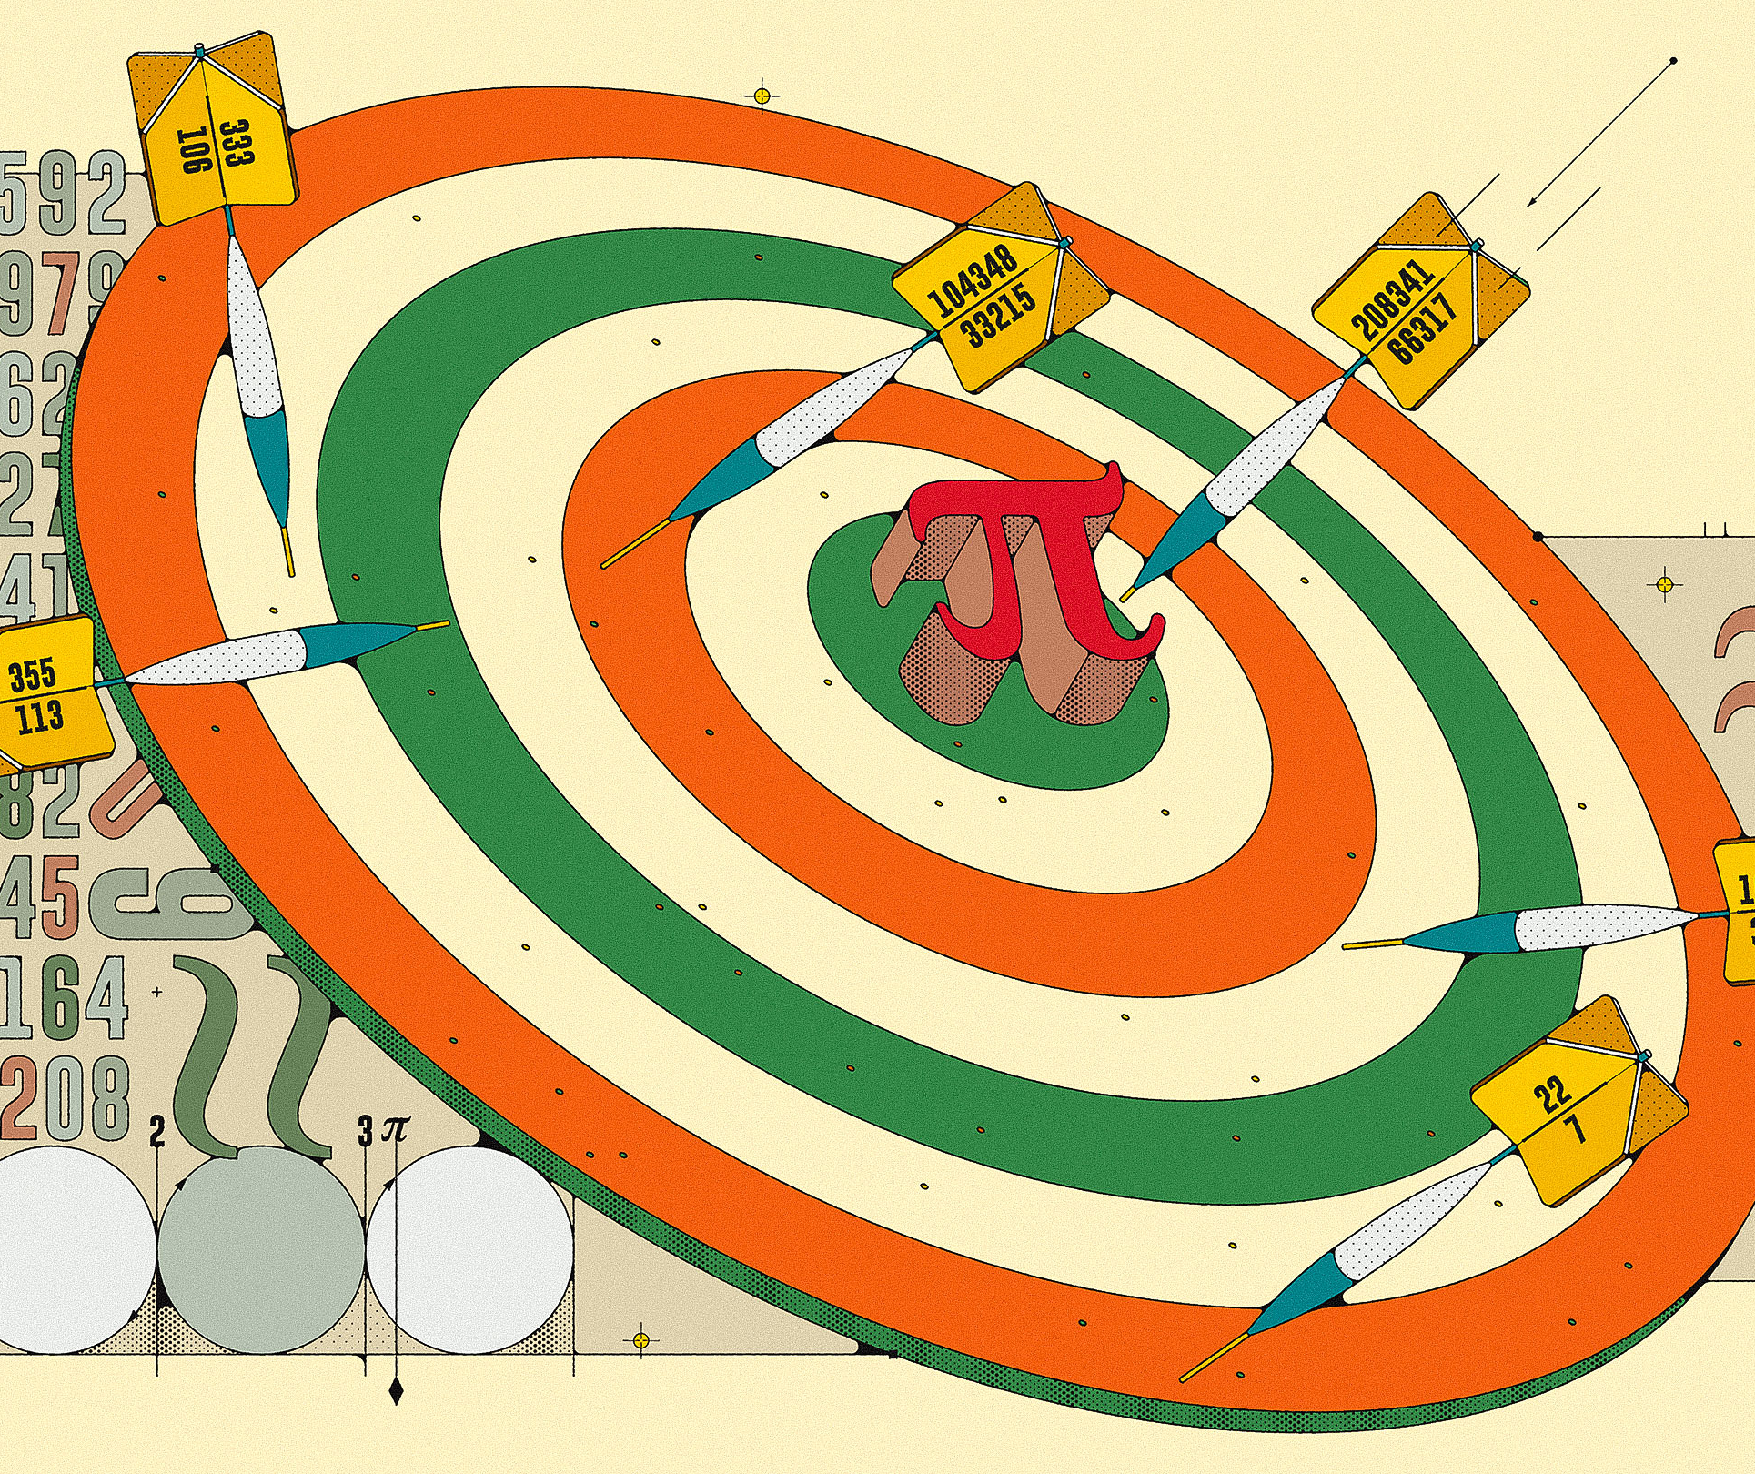
What is Approximation?
Approximation is a value or quantity that is nearly but not exactly the same to the actual value.

Slide 32
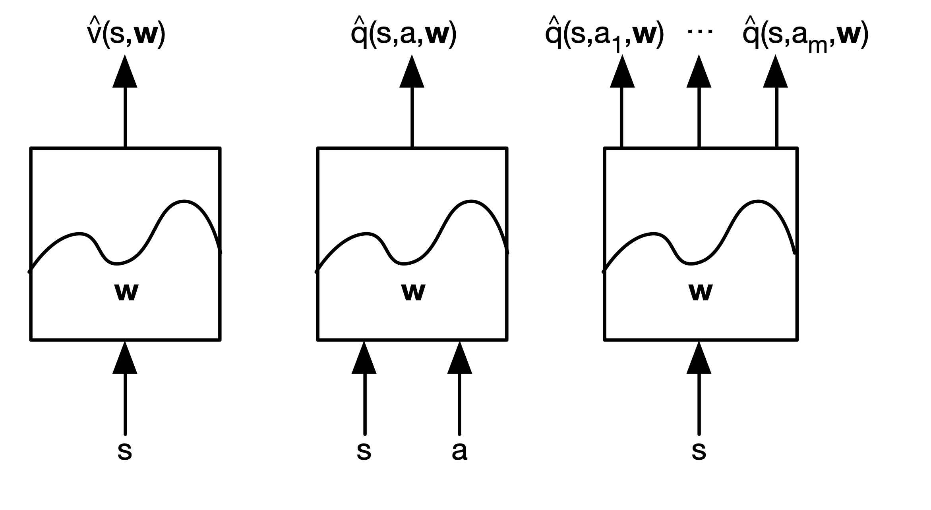
Types of Value Function Approximation

Slide 33
Types of Value Function Approximation
There are many function approximators, e.g.
Linear combinations of features
Neural Network
Decision Tree
Nearest neighbour

Slide 34
Types of Value Function Approximation
We consider are differentiable function approximators, e.g.
Linear combinations of features
Neural Network
Decision Tree
Nearest neighbour
Differentiable means that you can compute the derivative (slope) anywhere

Slide 36
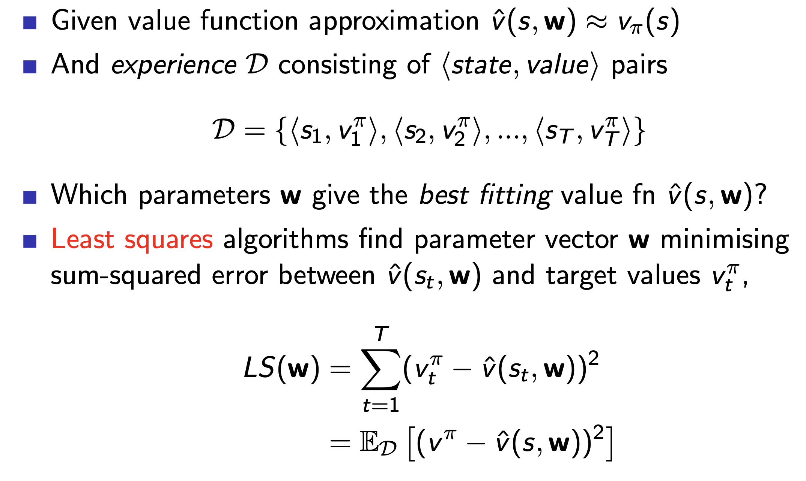
Least Squares Prediction

Slide 37
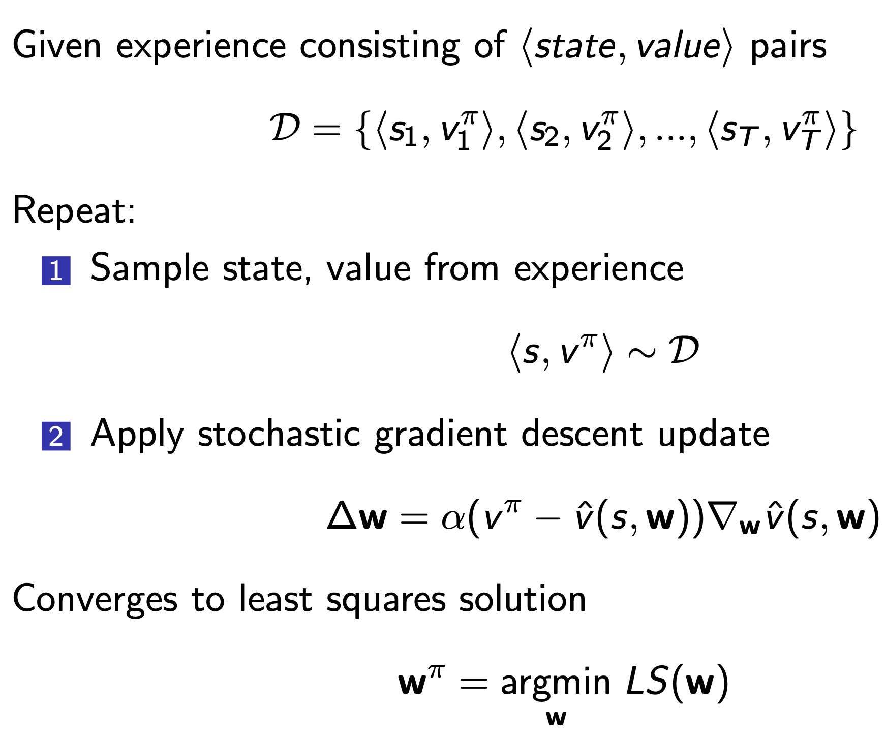
Experience replay

Slide 38
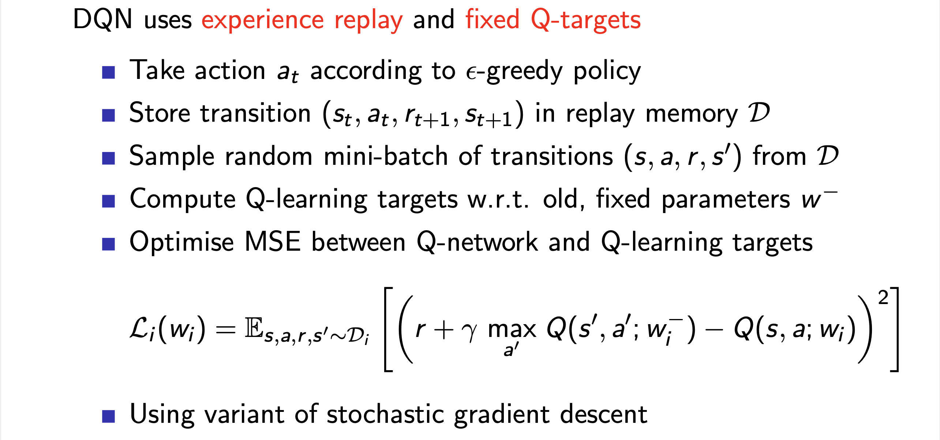
Deep Q Networks

Slide 39
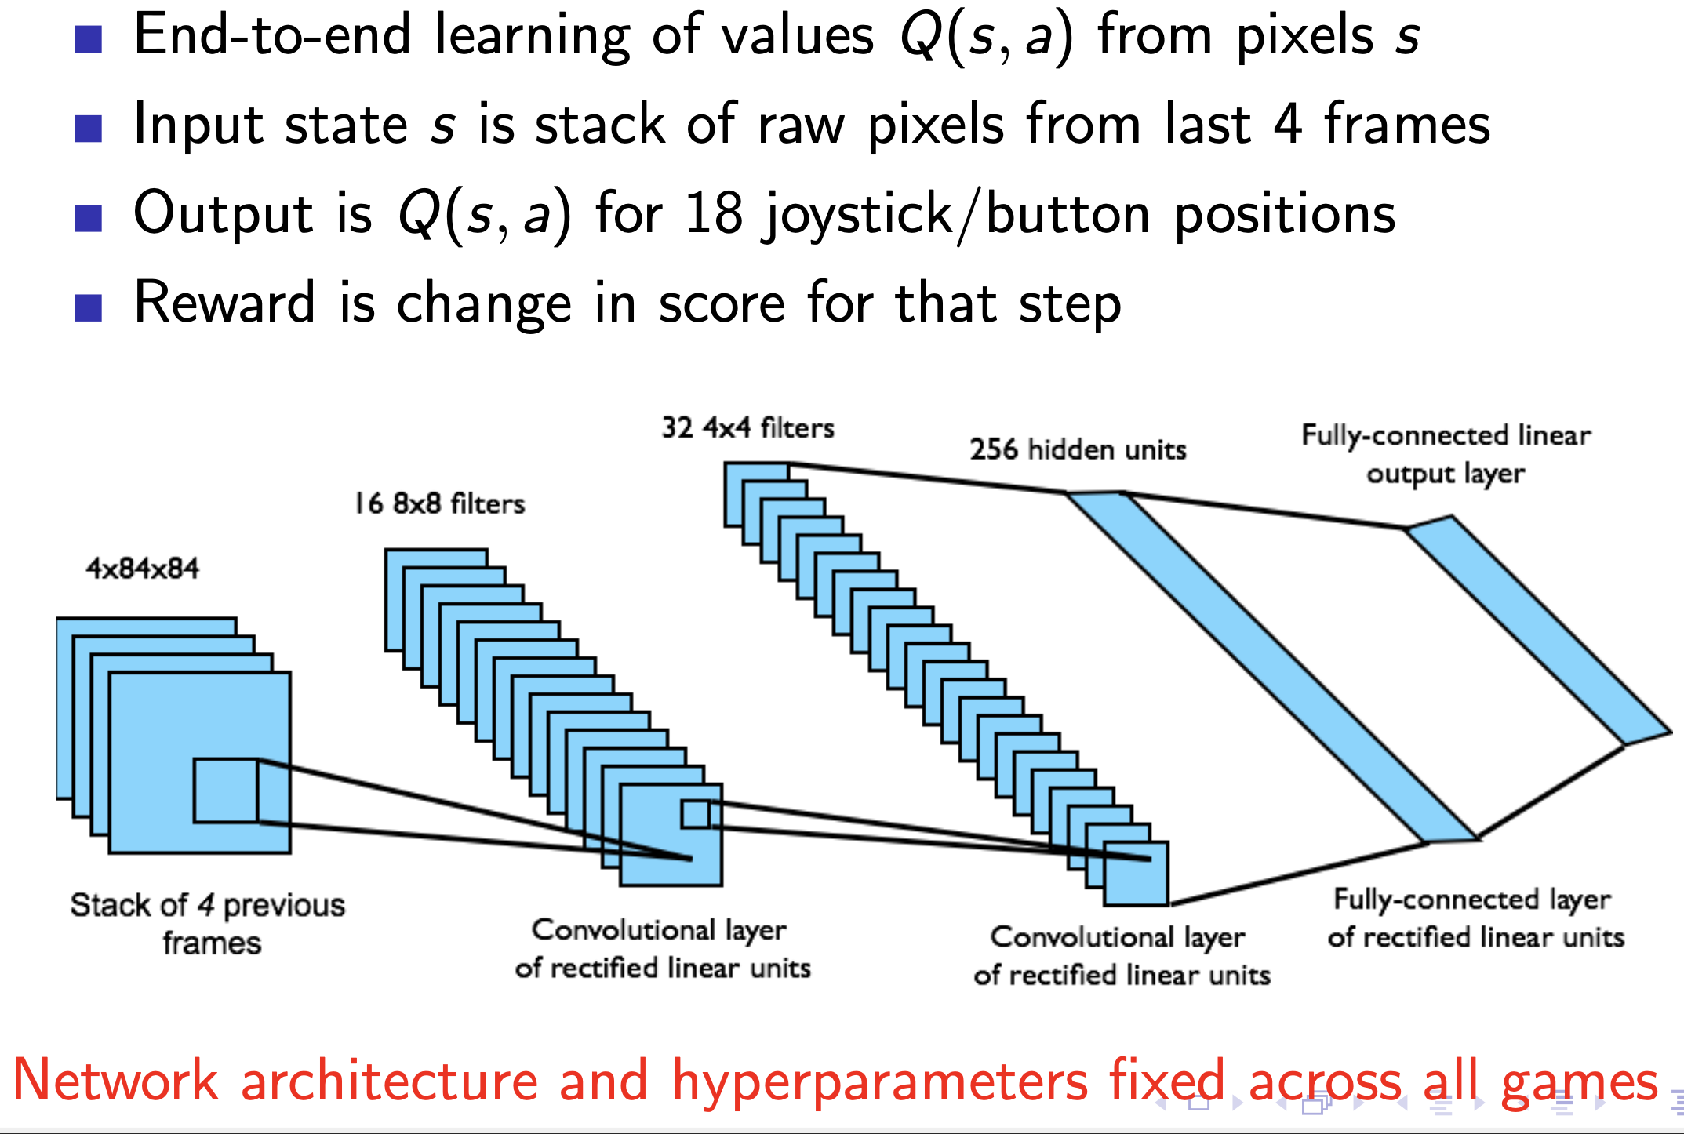
Deep Q Networks

Slide 40
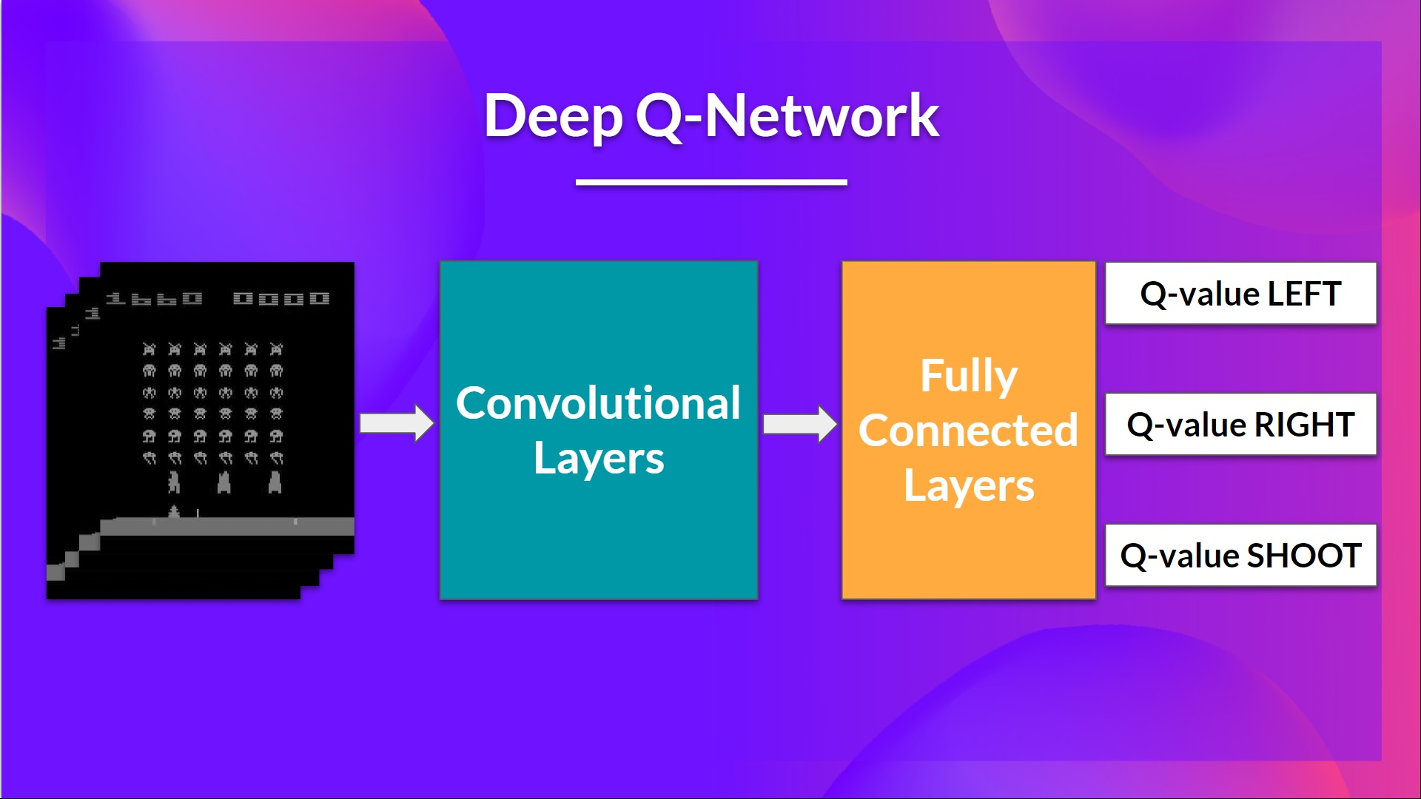
As input, we take a stack of 4 frames passed through the network as a state and output a vector of Q-values for each possible action at that state.

Slide 41
Then, like with Q-Learning, we just need to use our epsilon-greedy policy to select which action to take.

Slide 42
When the Neural Network is initialized, the Q-value estimation is terrible.

Slide 43
But during training, our Deep Q-Network agent will associate a situation with the appropriate action and learn to play the game well.

Slide 44
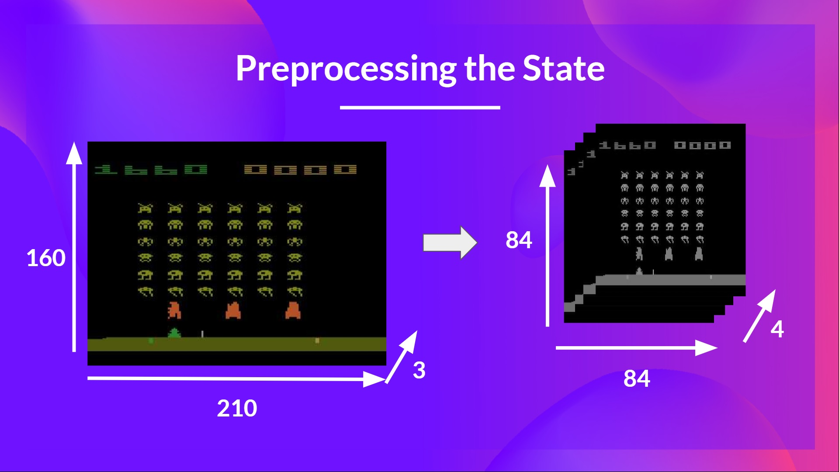
Reduce the state space to 84x84

Slide 45
Grayscale each frame.

Slide 46
Stack four frames together

Slide 47
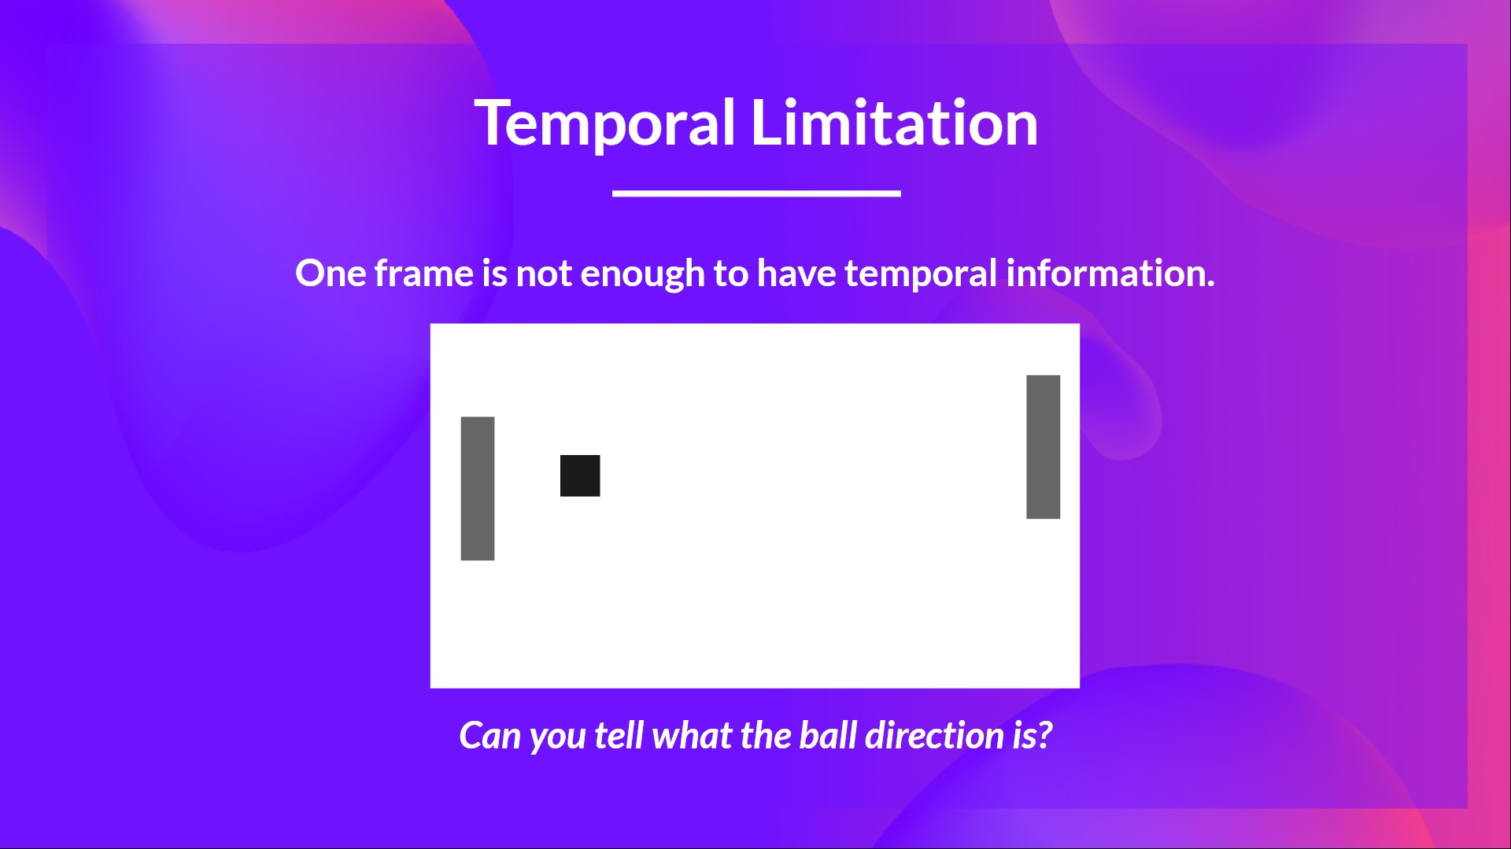
Why do we stack four frames together? We stack frames together because it helps us handle the problem of temporal limitation.

Slide 48
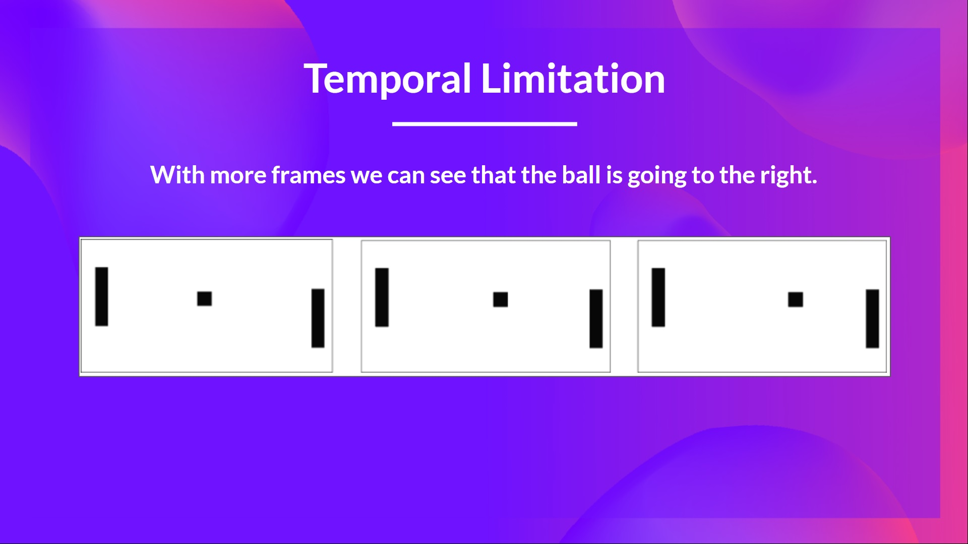
Using only one frame is not enough to have a sense of motion. If we add three more frames, we can see the direction of the ball is going to the right.

Slide 49
Then the stacked frames are processed by three convolutional layers. These layers allow us to capture and exploit spatial relationships in images.

Slide 50
Finally, we have a couple of fully connected layers that output a Q-value for each possible action at that state.

Slide 51
Deep Q-Learning uses a neural network to approximate, given a state, the different Q-values for each possible action at that state.

